Slide 1
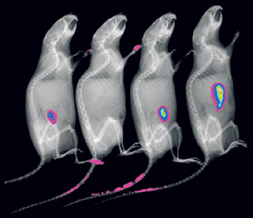
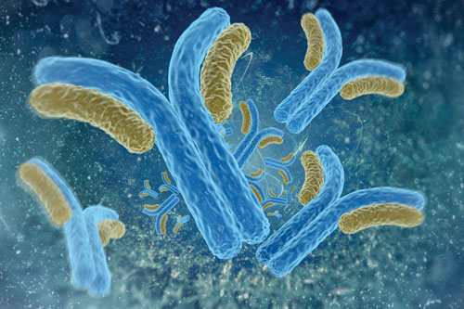
Molecular Imaging of Ovarian Cancer
Robert Kimelman
Secaucus High School – Secaucus, NJ
Summer Student Intern
Lewis Lab Group Meeting
August 26, 2016
http://www.nature.com/nmeth/journal/v6/n6/images/nmeth0609-465-I2.jpg
http://www.genengnews.com/gen-articles/the-antibody-dilemma/5550/
Notes:
Hello everyone, my name is Robert Kimelman and I am a rising senior at Secaucus High School. I have spent my summer working in the Lewis Lab with Brandon Nemieboka on his project regarding molecular imaging of ovarian cancer.

Slide 2
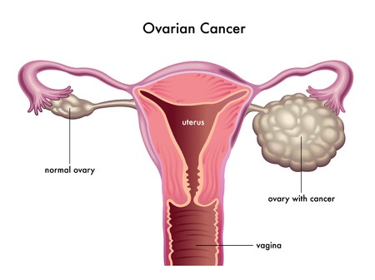
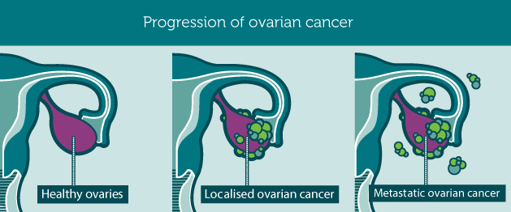
Background Information
Symptoms: very subtle and non-specific
Most fatal gynecologic malignancy
Molecular signature of L1CAM antigen
Sought to noninvasively perceive L1CAM in SKOV3 cell lines via PET/CT
http://ovariancancerday.org/about-ovarian/
http://www.dallas-obgyn.com/gynecology/ovarian-cancer/
Notes:
So, I’d like to start out with a little bit of background on ovarian cancer. The symptoms of ovarian cancer are commonly very subtle and non-specific -> things like bloating, abdominal pain and indigestion. It can sometimes be difficult to detect disease in its early stages when it is most optimal to begin treatment. Thus, we find it to be pertinent to develop the most biologically-advanced diagnostic imaging methods.
Not surprisingly, the 5 year survival rate of ovarian cancer is a mere 27% and it is the most fatal gynecologic malignancy.
Ovarian cancer possesses a molecular signature of L1 Cell Adhesion Molecules (also known as L1CAM), which makes it a potential candidate for targeting studies. L1CAM has been shown to have a dual role in the body and in cancers specifically: as an adhesion between cells and a motility promoting molecule that plays a role in cancer metastasis.
The overexpression of L1CAM is often linked to aggressive disease. L1CAM has also been found to be highly involved in cell motility, metastatic formation, tumor progression, and it is a predictor for disease progression and survival.
Retrieved L1CAM targeting antibody from Cheung Lab.

Slide 3
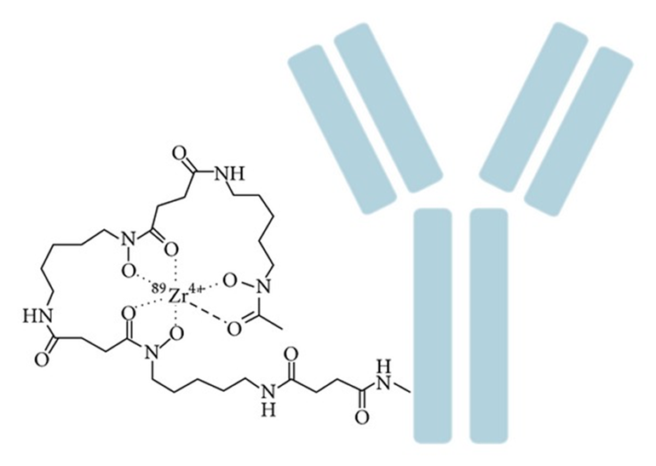
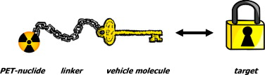
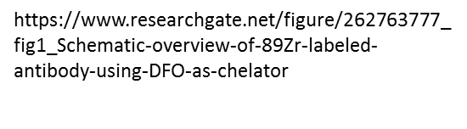
Background Information
Positron emission tomography is at forefront of cancer “theranostics”
Detects gamma rays emitted by isotopes to visualize radioactivity
PET radiopharmaceuticals consist of:
A molecular structure
A positron emitting radionuclide
Zirconium-89 labeling is favorable for PET
Use of desferrioxamine (DFO) is very effective
http://www.sciencedirect.com/science/article/pii/S0720048X09006913
Notes:
As we all know, PET imaging is at the forefront of cancer “theranostics,” or therapy and diagnostics combined.
What this imaging modality does is detect gamma rays that are expelled by radioisotopes apart of the radiopharmaceuticals and display this radioactivity in images.
So radiopharmaceuticals are the substances that are injected into patients that target specific agents. They include a molecular structure and a positron emitting radionuclide, which causes the illumination seen in the images. As you can see in the image on the bottom left, the radionuclide is attached to the biomolecule via a linker, or specifically, the chelator DFO, which is synthesized to target a specific antigen. An ideal probe would specifically localize to the cancerous tissue. If we see this, we know that our antibody should accumulate in the cancer in human patients and we can thus innovate cancer diagnostics by improving the time at which it is done and the overall quality of the images.
The radioisotope zirconium-89 has had a track record of producing high quality images due its low positron energy and 78 hour half life. A relatively low positron energy produces higher resolution images. (Similar to the half life of antibodies)
DFO produces high quality images as well. It is a bifunctional chelator – wraps around a radiometal and binds to another biomolecule via a separate appendage.

Slide 4
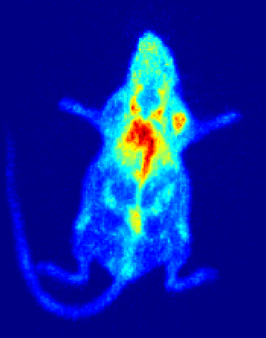
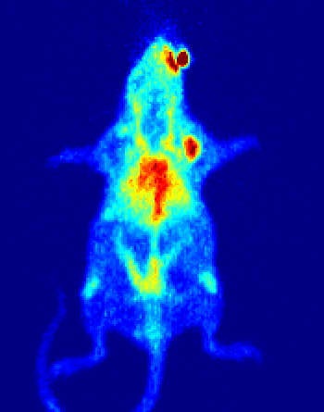
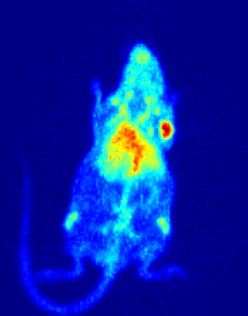
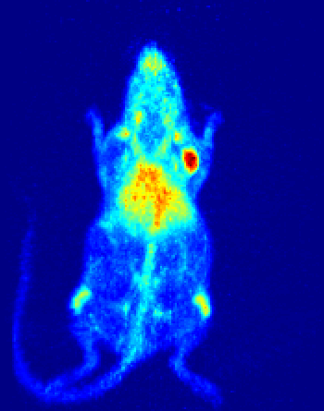
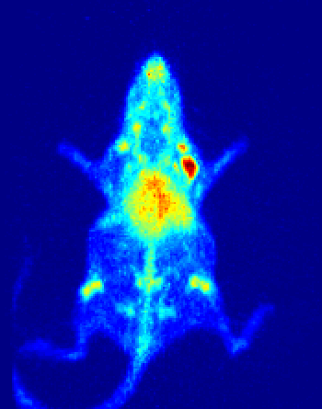
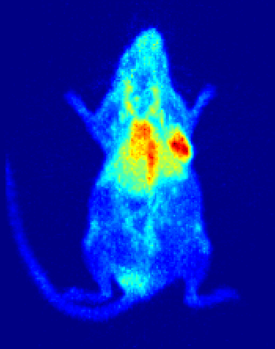
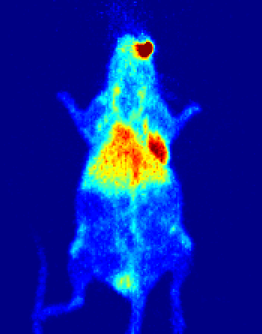
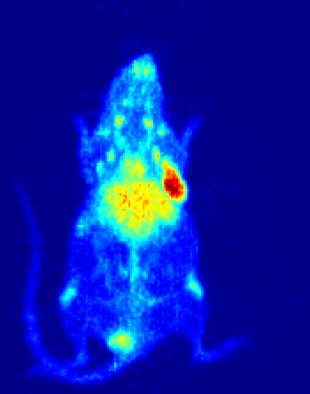
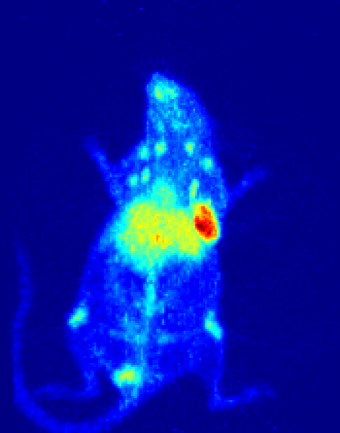
⁸⁹Zr-DFO-H3E7 IgG4 Mutated
24h
48h
72h
96h
120h
Max
Mouse 1
0
Max
Mouse 2
0
Notes:
These are images you guys saw last week with Brandon, but I decided to bring them up so I can refresh your memory. So these are images of A-th-I-mic nude mice bearing subcutaneous skov3+ xenografts injected with a zirconium-89 labeled IgG4 antibody targeting L1Cam.
These images aren’t the best because they show a lot of non-specific background uptake in non-target organs such as the liver and blood pool, but that does clear out as we move forward in time to 120 hours. In addition, we see the tracer accumulate in the tumor through 120 hours.
We believe there was so much background uptake in the mice because the antibody had a very low specific activity of one microcuri/microgram, which we are actively working on increasing. What’s promising about these images is that the images do not reveal any significant kidney uptake.
When we previously injected a non-mutated IgG4 targeting the same molecule –L1CAM- there was significant uptake in the kidney, but as you can see from these images (circle kidneys) the mutated IgG4 did not have significant accumulation in the kidneys through 120 hours, so we were pleased with that result. We anticipated this result because the mutated IgG4 antibody was engineered with this mutation to prevent it from fragmenting.

Slide 5
Notes:
We confirmed the imaging data with a biodistribution study with the imaged mice and as you can see here, (circle kidney) kidney uptake is quite low. As I mentioned previously, the specific activity of that antibody was rather low, the reasons for which we are not entirely sure about because all of the other antibodies that we’ve used against this target that are engineered using the same process have high specific activities around 6-7 microcuris/microgram which are of 10 molar equivalence of DFO. In an effort to increase our specific activity *next slide*

Slide 6
Conjugation/Labeling Conditions
H3E7-4M DFO Conjugation
500 ug antibody
DFO-antibody molar ratio – 20:1
pH 9, 37 °C for 60 minutes in 1 mL
⁸⁹ZrDFO-H3E7-4M Labeling
236 ug antibody, 650 uCi Zr
pH 7.4, RT for 60 minutes
Crude RCY: 95% RCP: 99% SA: 2.75 uCi/ug
Notes:
We decided to increase the molar equivalence of DFO to 20 and here are the conditions for the conjugation and for the labeling.
(Numbers) This was a successful labeling, as you can see we were able to achieve a crude radiochemical yield of 95% (circle graph on top) and after purification, we have a purity of greater than 99% with a specific activity of 2.75 microcuris/ microgram (circle as your saying), which is still not as high as the other antibodies that we’ve labeled against this target, but it is nearly three times better than the antibodies that we labeled and imaged in the previous slides.

Slide 7
Serum Stability
Notes:
We were interested in how stable the radiolabeled antibody would be in serum so we could have an idea of how the blood of a mouse or human would affect the antibodies. We conducted this stability assay at 37 degrees celcius for 7 days, and as you can see from the graph, the antibody was greater than 99% stable through 7 days.

Slide 8
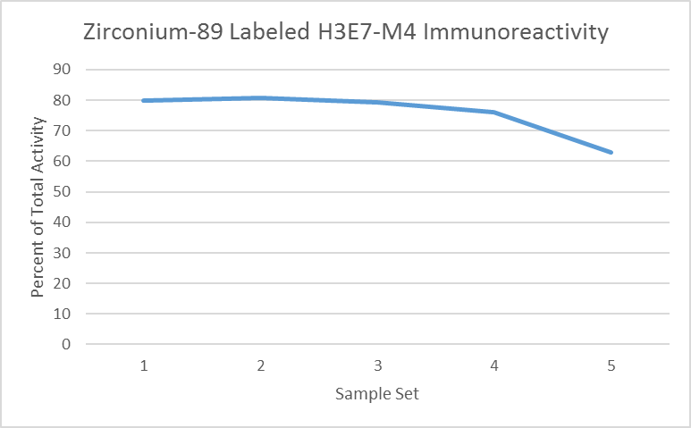
Immunoreactivity
Notes:
We were also interested in seeing how immunoreactive the antibody was post-bioconjugation and radiolabeling. As you know, non-specific DFO conjugation can have a negative impact on the binding capability of the antibody. So we performed this assay and found that the antibody was about 80% immunoreactive.

Slide 9
Notes:
IMR-32 is a neuroblastoma cell line. (L1CAM was first discovered as a neuron marker and has implications in brain development.) In collaboration with the Cheung lab, we did flow cytometry, we incubated the IMR-32 cell line with three different concentrations of our antibodies – both the dfo conjugated one (the green line you see here (point)) and the antibody that is not conjugated with dfo, and also a negative control antibody. What you can see here is that the dfo conjugation did not negatively affect the binding according to the flow data.
MFI is mean fluorescence intensity.

Slide 10
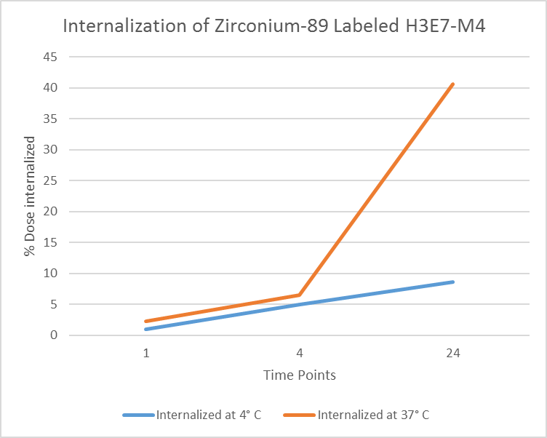
Zirconium-89 Labeled H3E7-4M Internalization Assay
Notes:
We performed a cell internalization assay in order to observe how much of the zirconium-89 radiolabeled antibody H3E7-4M is uptaken. We plated and incubated cells at 4 degrees celcius and 37 degrees celcius. We used an acid wash and a base wash to collect surface bound activity and internalized activity at 1, 4, and 24 hours.
The acid removes the bound antibody from the cells and the base lyses the cell, releasing the internalized antibody. After analyzing the data, we found that the antibody was slowly uptaken into the cells as you can see here (point).
There is not a huge difference between the 1 and 4 hour time points, however, we see this large increase of internalized activity at the 24 hour time point, suggesting that the antibody internalizes rather slowly. We also see a significant difference at the 24 hour time point suggesting that this internalization is an active process.

Slide 11
Conclusions and Future Work
Minimal uptake of Zirconium-89 labeled H3E7-4M seen in kidneys
Significant tumor uptake of Zirconium-89 labeled H3E7-4M
SKOV3+ cells are actively internalizing Zirconium-89 labeled H3E7-4M
Zirconium-89 labeled H3E7-4M is about 80% immunoreactive
Future Work:
Images with higher specific activity and biodistribution
Notes:
Due to the mutation
Tells us that we can move forward with this antibody and continue experimenting
We know this due to the difference between the 24 hour time points at 37 degrees celcius and 4 degrees celcius

Slide 12
Techniques I’ve Learned
Cell Culture
Pipetting
PET/CT Imaging
HPLC
Western Blotting
Antibody Conjugation
Radiolabeling
Biodistribution
RARC Certified
Tube Weighing
Mouse Subcutaneous Xenografting
Mouse Intravenous Tail Injections
Immunoreactivity Cell Assay
Internalization Cell Assay
Zirconium-89 Preparation
Orthotopic (Mouse) Surgery
Notes:
So, not only did I come into this summer knowing absolutely nothing about what I was going to research, but I also have never done research in my life. I learned such a great deal of information about both science and life skills during my time here this summer and I couldn’t be more privileged and thankful for that. This list really does no justice to all that I’ve learned this summer. So with that… *next slide*

Slide 13
Acknowledgements
Brandon Nemieboka
Dr. Jason Lewis
The Lewis Lab
Notes:
I’d like to thank my spectacular mentor Brandon who was taught me more this summer than all my teachers have throughout high school, Dr. Lewis for granting me this humbling and amazing opportunity and all of his help along the way, as well as everyone in the Lewis Lab for support, mentorship, and friendship that I will cherish forever.

